Slide 1
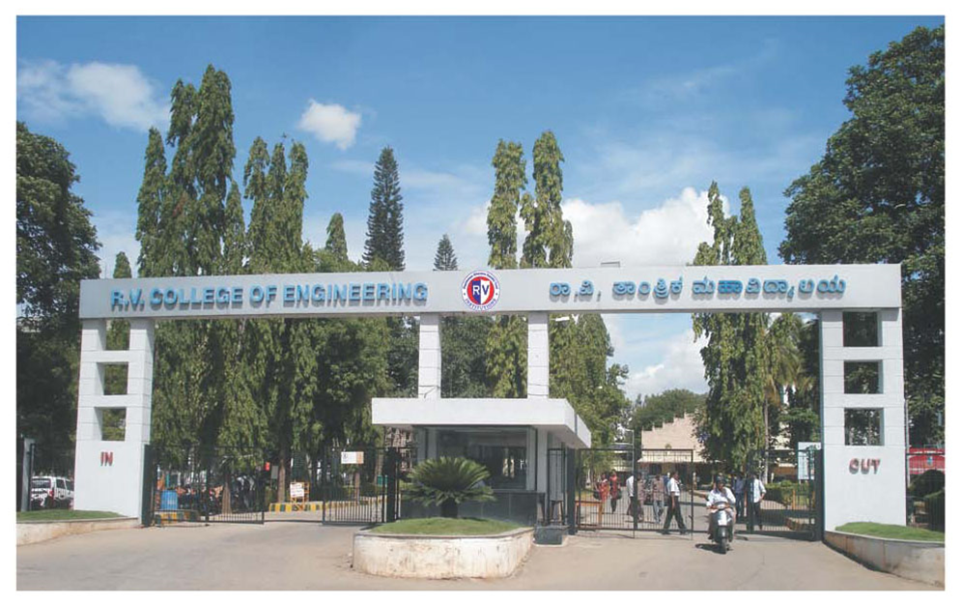
INTERDISCIPLINARY PHASE 1 PRESENTATION
Topic : Real Time Cashew Kernel Classification using Deep Learning

Slide 2
Team ID 190
Program | USN | Name
ECE | 1RV23EC408 | RAVIKANT
ECE | 1RV23EC410 | SAGAR T NAYAK
BT | 1RV23BT404 | YOGEESH A S
CSE | 1RV23CS405 | KIRAN H R
CSE | 1RV23CS407 | MANOJ KUMAR B V
Internal Guide
Dr. Veenadevi S .V
Associate Professor
Department of Electronics & Communication Engineering

Slide 3
INTRODUCTION
Cashew kernels are a valuable product in the global food market, and their quality affects both price and consumer choice. Traditionally, kernels are graded by hand based on size, shape, color, and surface condition. Skilled workers visually inspect and sort them into categories like whole, split, or scorched.
However, manual grading is slow, tiring, and prone to mistakes, leading to inconsistencies in quality and profit loss. To solve this, the industry is moving toward automation using artificial intelligence and computer vision. Deep learning is especially useful because it can learn to recognize complex visual patterns from large sets of images.
This project focuses on developing a real-time system that automatically classifies cashew kernels using deep learning. It aims to replace manual inspection with a faster, more reliable, and scalable method, helping improve product quality, reduce labor needs, and boost overall efficiency in cashew processing.

Slide 4
LITERATURE SURVEY
Paper Title, Author & Publication | Summary | Key Findings | Research Gap
Title: A Low-Cost Deep-Learning-Based System for Grading Cashew Nuts. Authors:Van-Nam Pham,Quang-Huy Do Ba , Duc-Anh Tran Le , Quang-Minh Nguyen , Dinh Do Van .(2024) Journal:journal Computers, Volume 13, Issue 3, Article 71, in March 2024.(published by MDPI,Q2) | The paper introduces an affordable, automated system that employs deep learning to grade cashew nuts. By integrating YOLOv8 with Transformer models, the system classifies cashew nuts into four quality grades and utilizes an actuation mechanism for physical sorting. | YOLO v8 –Transformer model offers 98.4% mAP and 2.96% error rate, outperforming baselines. supports cost-effective industrial cashew sorting | Only focused on 4 types which include good, error1, error 2, error 3 Lack of real-time cashew grading systems on conveyors using low-cost cameras Performance may vary based on the quality and specifications of the hardware used.

Slide 5
LITERATURE SURVEY
Paper Title, Author & Publication | Summary | Key Findings | Research Gap
Title: Precise Cashew Classification using Machine Learning Authors: Sowmya Nag Karnam, Veenadevi Siddanahundi Vaddagallaiah, Pradeep Kooganahalli Rangnaik, Akshaya Kumar, Charan Kumar, Bidadi Mahesh Vishwanath. Journal: Engineering, Technology & Applied Science Research, Vol. 14, No. 5, Oct. 2024(Q2) | The study evaluates deep learning models (YOLOv5, YOLOv9, CNN) for classifying cashews into five categories: whole, broken, split-up, split-down, and defect. YOLOv5 achieves 97.65% accuracy and 0.025 s inference time, making it ideal for real-time industrial applications. | YOLOv5 outperforms YOLOv9 and CNN with the highest accuracy (97.65%) and fastest inference time (0.025 s/image). Data augmentation enhances model robustness against variations in lighting and orientation. | It also lacks discussion on handling environmental factors like lighting variations or nut-splitting phenomena, which are critical for industrial deployment. Does not taken Hybrid model for case study only focused on 5 categories.

Slide 6
LITERATURE SURVEY
Paper Title, Author & Publication | Summary | Key Findings | Research Gap
Title: Implementation and Assessment of New Hybrid Model for Cashew Kernel Classification Authors: Sowmya Nag K. and Dr.Veenadevi S. V Journal: International Journal of INTELLIGENT SYSTEMS AND APPLICATIONS IN ENGINEERING. (11/03/2024)(Q4) | The paper proposes nine hybrid models combining CNNs (VGG16, ResNet50, InceptionV3) with machine learning (SVM, RF, KNN) for cashew classification. ResNet-50 + SVM achieved 97.40% accuracy, outperforming manual and existing methods, suitable for industrial usage. | ResNet-50 + SVM tops with 97.40% accuracy; VGG16 + RF at 95%, ResNet50 + RF at 90%. Outperformed prior works, with accuracies up to 96.8% from existing studies | Lack real time implementation . Dataset Diversity: does not include images from various sources and conditions (e.g., different lighting, backgrounds) would enhance model robustness.

Slide 7
LITERATURE SURVEY
Paper Title, Author & Publication | Summary | Key Findings | Research Gap
Title: A Novel Approach to Cashew Nut Detection in Packaging and Quality Inspection Lines Authors: Van-Hung Pham, Ngoc-Khoat Nguyen, Van-Minh Pham Journal: International Journal of Advanced Computer Science and Applications (IJACSA), Volume 13, Issue 12, 2022(Q3) | The paper proposes YOLOv7 for detecting cashew nuts (good, broken, not peeled) in packaging lines. YOLOv7-tiny achieves high accuracy with 6.2M parameters, suitable for real-time quality inspection. | YOLOv7-tiny achieves high accuracy with 6.2M parameters, ideal for real-time cashew detection. CASHEW dataset ensures robustness across brightness and angles, enhancing detection reliability. | Lacks exploration of hybrid models combining YOLOv7 with techniques like CNN for improved accuracy. Does not address real-time conveyor-based sorting with low-cost hardware integration. does not include any market grading.

Slide 8
LITERATURE SURVEY
Paper Title, Author & Publication | Summary | Key Findings | Research Gap
Title:CashNet-15: An Optimized Cashew Nut Grading Using Deep CNN and Data Augmentation Authors:Sivaranjani, S. Senthilrani, B. Ashokumar, A. Senthil Murugan journal:Proc. Int. Conf. on Systems Computation Automation and Networking, 2019 | Introduces CashNet-15, a 15-layer deep CNN architecture with data augmentation for binary classification of cashew grades (whole vs others). Uses 8 convolutional, 4 max-pooling, 1 fully connected, activation, and dropout layers. Achieves 97.7% accuracy, outperforming prior methods. | Highest reported accuracy (97.7%) Employs data augmentation to reduce overfitting Custom CNN architecture optimized for the task Hyperparameter optimization (SGD with Beta, LReLU) | Only binary classification (whole vs others) Limited grade granularity Dataset size relatively small (1000 images) No direct multi-class extension Lack real time implimentation.

Slide 9
LITERATURE SURVEY
Paper Title, Author & Publication | Summary | Key Findings | Research Gap
Title: An Improvised Algorithm For Computer Vision Based Cashew Grading System Using Deep CNN Authors: Sivaranjani, S. Senthil Rani, B. Ashok Kumar, A. Senthil Murugan IEEE, 2019 | Proposes an improvised deep CNN-based framework for automated grading of cashew nuts, addressing the limitations of manual and traditional machine learning approaches. The system extracts features (shape, size, color, texture) automatically and optimizes CNN parameters for better classification. | Automates grading, reducing labor and subjectivity Deep CNN extracts features without manual intervention Incorporates optimization techniques (dropout, SGD, ReLU, transfer learning) Potential for high accuracy and scalability | Lacks experimental results or real-world deployment data No direct comparison with state-of-the-art deep learning models Future work needed to address multilabel and small dataset issues
Inference:
All The research paper lack implementation full working model which include hardware and software integration.
The paper not considered splits (which is curial)in their research process.
None of the paper considered “Industrial Grading” like W180.W200 etc..

Slide 10
PROBLEM STATEMENT & OBJECTIVES
Problem Statement:
Despite advancements in automated cashew kernel grading using machine vision and deep learning, existing systems face challenges in real-time processing, hardware constraints, image quality, defect detection, and dataset limitations. These issues hinder the development of efficient, accurate, and scalable grading solutions, impacting product quality, labor efficiency, and profitability in the cashew processing industry.
Objectives:
Develop an image processing system to capture raw cashew kernel images and perform data preprocessing.
Design and implement algorithms for feature extraction, data analysis, and classification of kernel variations.
Apply AI techniques to accurately detect, classify, and grade defects in cashew kernels.
Integrate reliable hardware and software components for efficient, real-time testing and grading.

Slide 11
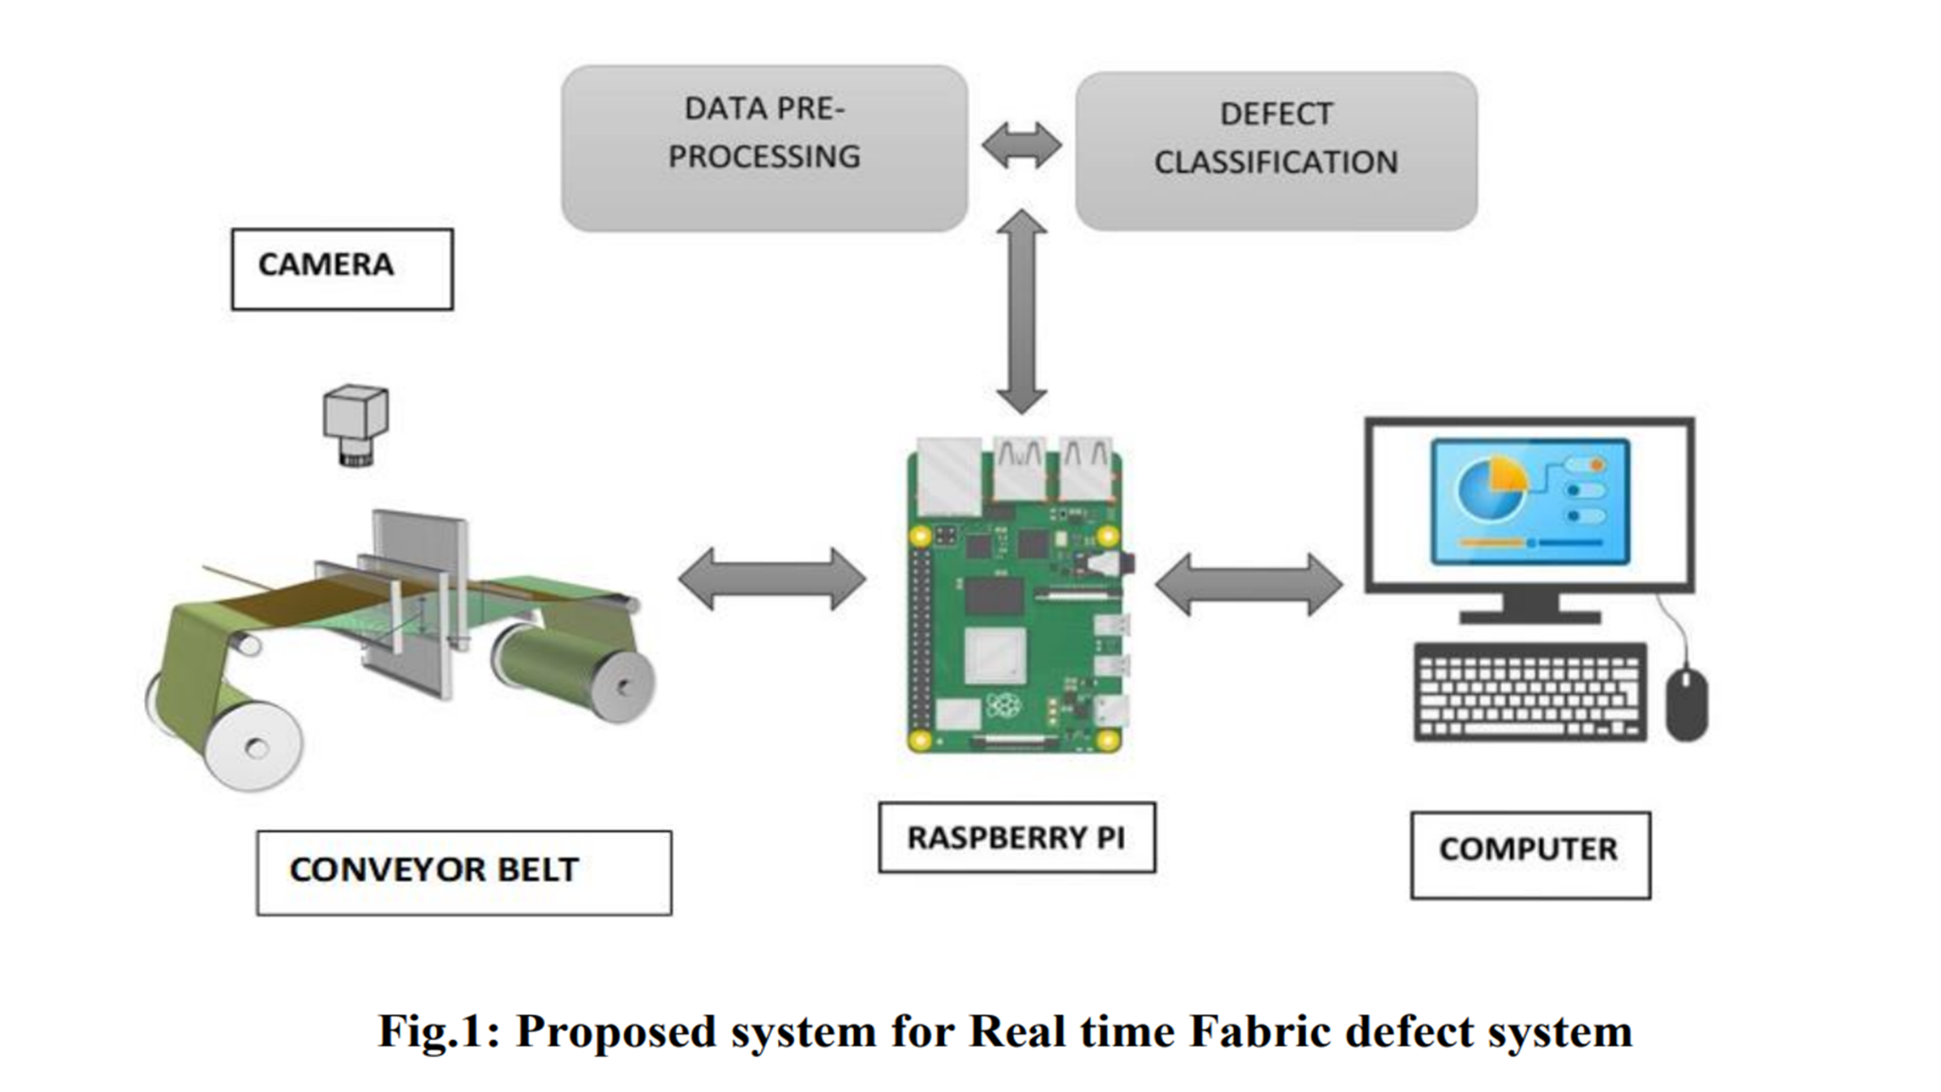
METHODOLOGY
Data
pre-processing
Cashew
Classification
Fig : Proposed system for Real time Cashew classification

Slide 12
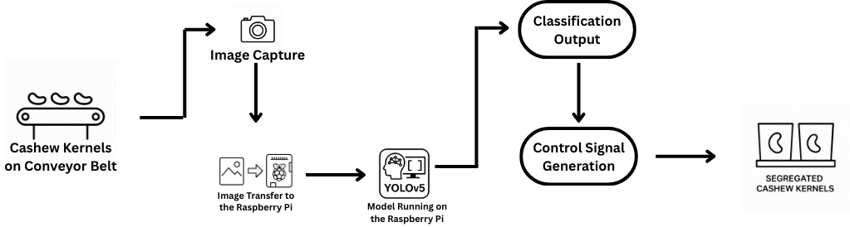
METHODOLOGY
Fig : Proposed system for Real time Cashew classification

Slide 13
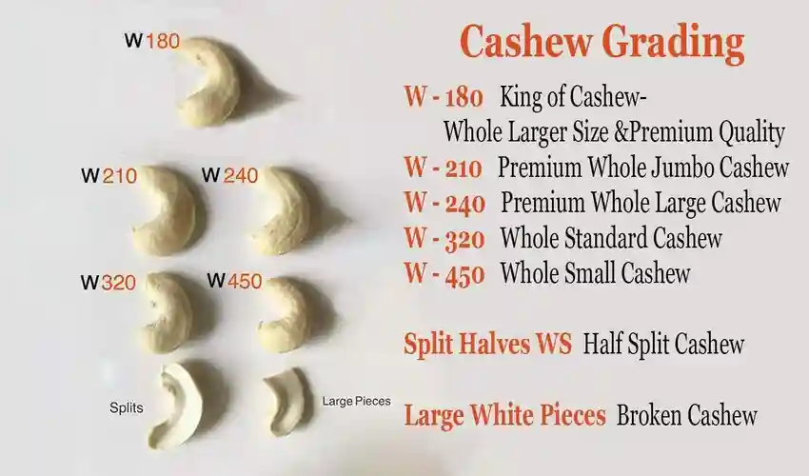
METHODOLOGY

Slide 14
METHODOLOGY
Image Acquisition & Preprocessing: Capture diverse cashew kernel images and apply preprocessing (resizing, normalization, augmentation) to build a consistent dataset.
Labeling & Model Training: Manually label kernels by grade (whole, split, etc.) and train a deep learning model (e.g., YOLO) for classification.
Real-Time Classification: Deploy the model on edge devices for real-time detection and grading of kernels on a moving conveyor.
Hardware Integration: Connect the classifier to microcontrollers (e.g., Arduino) and sensors to control actuators for sorting.
Automated Sorting: Sort kernels into graded bins using actuators, enabling efficient and consistent automated grading.

Slide 15
EXPECTED OUTCOMES
Accurate and consistent classification of cashew kernels into defined grades (whole, split, scorched, etc.).
Real-time processing capability enabling fast grading on a moving conveyor belt.
Reduced reliance on manual inspection, lowering labor costs and human errors.
Improved overall efficiency and throughput in cashew processing.
Scalable and robust hardware-software integration suitable for industrial deployment.

Slide 16
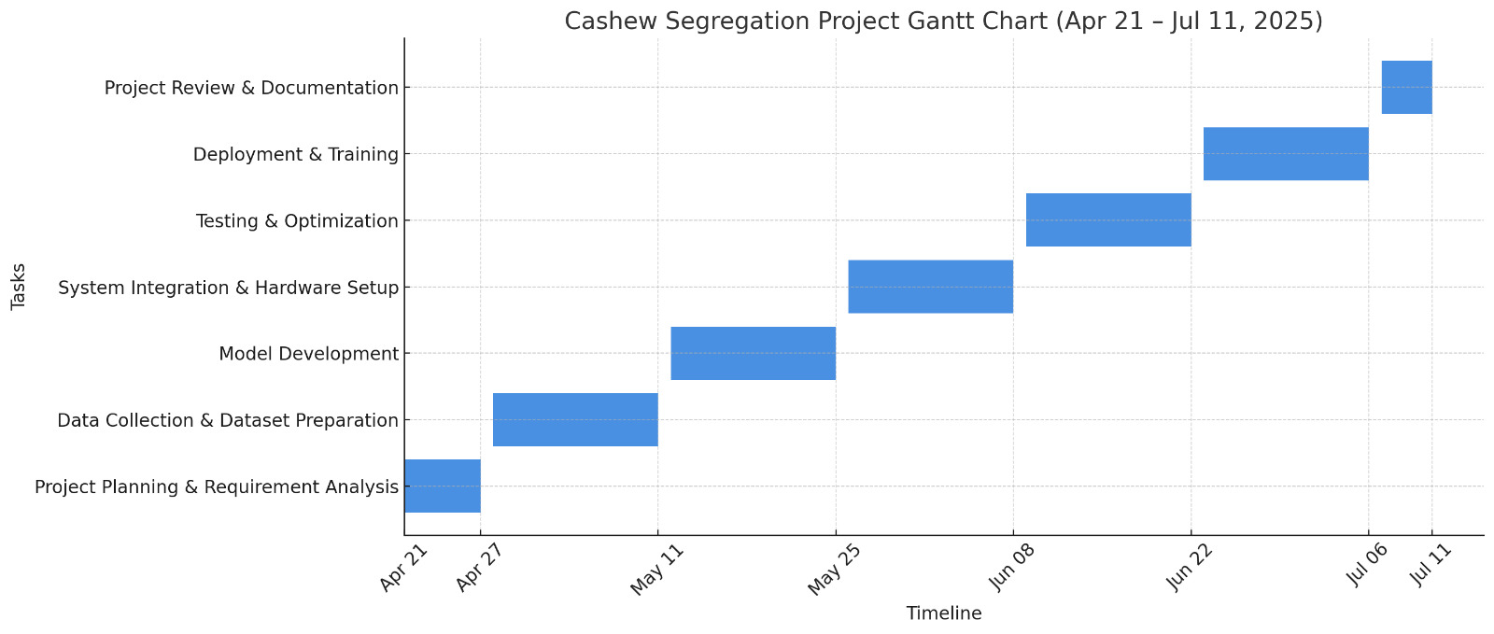
TIMELINE(GANTT CHART)

Slide 17
REFERENCES
A. Sivaranjani, S. Senthilrani, B. Ashokumar, and A. Senthil Murugan, "An Improvised Algorithm For Computer Vision Based Cashew Grading System Using Deep CNN," in 2018 IEEE International Conference on Current Trends in Advanced Computing (ICCTAC), pp. 1-6, July 2019.
Arun M O, Aneesh G Nath, and Shyna A, "Automated Cashew Kernel Grading Using Machine Vision," in 2016 International Conference on Next Generation Intelligent Systems (ICNGIS), IEEE, pp. 1-6, 2018.
A. Sivaranjani, S. Senthilrani, B. Ashokumar, and A. Senthil Murugan, "CashNet-15: An Optimized Cashew Nut Grading Using Deep CNN and Data Augmentation," in Proceedings of International Conference on Systems Computation Automation and Networking (ICSCAN), IEEE, pp. 1-6, 2019.
Shyna A and Reena Mary George, "Machine Vision based Real Time Cashew Grading and Sorting System using SVM and Back Propagation Neural Network," in 2017 International Conference on Circuits Power and Computing Technologies (ICCPCT), IEEE, pp. 1-6, 2017.
Pham, V.-N., Do Ba, Q.-H., Tran Le, D.-A., Nguyen, Q.-M., Do Van, D., & Nguyen, L., "A Low-Cost Deep-Learning-Based System for Grading Cashew Nuts," Computers, vol. 13, no. 3, p. 71, 2024.
Raj, R., Nagaraj, S.S., Ritesh, S., Thushar, T.A. and Aparanji, V.M.,Fruit Classification Comparison Based on CNN and YOLO. In IOP Conference Series: Materials Science and Engineering (Vol. 1187, No. 1, p. 012031). IOP Publishing,2021.

Slide 18
REFERENCES
7. M. A and P. N. Renjith,Classification of Durian Fruits based on Ripening with Machine Learning Techniques,2020 3rd International Conference on Intelligent Sustainable Systems (ICISS), Thoothukudi,pp. 542-547,
8. S. N. Karnam, V. S. Vaddagallaiah, P. K. Rangnaik, A. Kumar, C. Kumar, and B. M. Vishwanath, "Precise Cashew Classification using Machine Learning," Engineering, Technology & Applied Science Research, vol. 14, no. 5, pp. 17414–17421, Oct. 2024, doi: 10.48084/etasr.8052
9. V. Gautam, R. G. Tiwari, A. Misra, D. Witarsyah, N. K. Trivedi and A. K. Jain, Dry Fruit Classification Using Deep Convolutional Neural Network Trained with Transfer Learning,2023 International Conference on Advancement in Data Science, E-learning and Information System (ICADEIS,pp. 1-6, doi: 10.1109/ICADEIS58666.2023.10270982,2023.
10. S. E. Sunday, R. Ji, A. N. Abdalla and H. Bian,Fruit Image Classification using the Inception-V3 Deep Learning Model,2023 International Conference on the Cognitive Computing and Complex Data (ICCD),pp. 227-230, doi: 10.1109/ICCD59681.2023.10420760,2023.
11. P. Nirale and M. Madankar, Analytical Study on IoT and Machine Learning based Grading and Sorting System for Fruits,2021 International Conference on Computational Intelligence and Computing Applications (ICCICA), Nagpur, India, 2021, pp. 1-6, doi: 10.1109/ICCICA52458.2021.9697161,2021.

Slide 19


